Slide 1

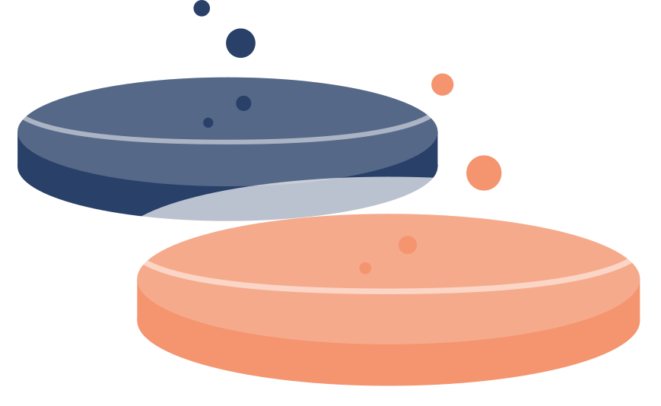
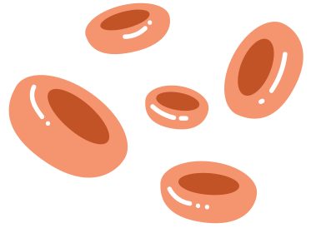

Balancium RX -
Drug-Drug Interaction Checker
Chehak Arora
Marius Nwobi
Franco Valdes
Andrew Normandin
David Rogers

Slide 2

Problem:
Pharmaceutical development is becoming more complex.
Risk of harmful drug - drug interactions
Can reduce drug efficacy.
Can increase toxicity.
Can create unforeseen side effects.
Data Set Sources:
Original DDI Dataset:
Interactions involving alimentary tract and metabolism drugs.
Drug names mapped to multiple PubChem CIDs (some drugs have more than one CID).
Molecular descriptors and chemical properties retrieved from PubChem.
One-CID-Per-Drug Dataset:
Derived by filtering the original dataset to retain a single representative CID per drug.
Ensures one unique ID per drug for cleaner analysis and comparison.
Final Data Sets:
Both datasets include chemical properties as predictors.
Interaction labels used as targets for machine learning models.
Notes:
Chehak The problem of drug-drug interactions has become more pressing with the increasing number of drugs available on the market. As pharmaceutical development becomes more complex, harmful DDIs can compromise drug efficacy, increase toxicity, or lead to unexpected side effects. These interactions pose serious risks to patient safety and healthcare outcomes. Given this context, there is an urgent need for robust, predictive methods to identify potential interactions early in the drug development process, minimizing adverse effects and improving therapeutic success rates. We sourced the original dataset from DDI data involving alimentary tract and metabolism drugs, mapped drug names to PubChem CIDs, and retrieved molecular descriptors from PubChem.
To refine the data, we created a second dataset by simplifying the original, keeping only one CID per drug. This allows us to compare how models perform with and without duplicate CIDs while using chemical properties as predictors and interaction labels as targets.

Slide 3



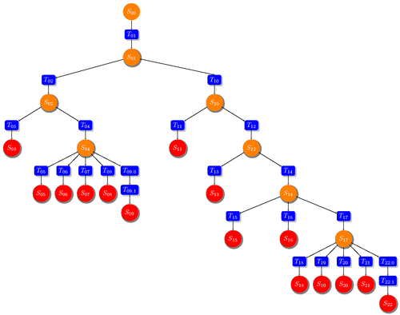

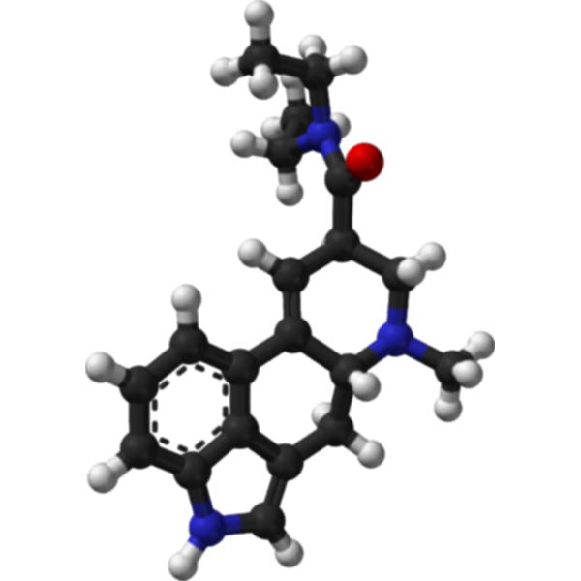
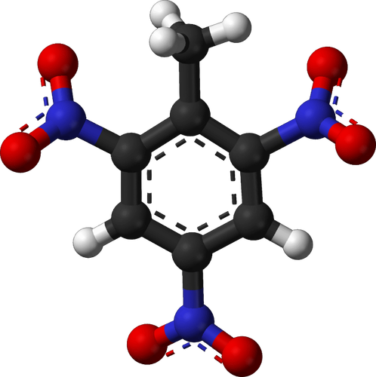
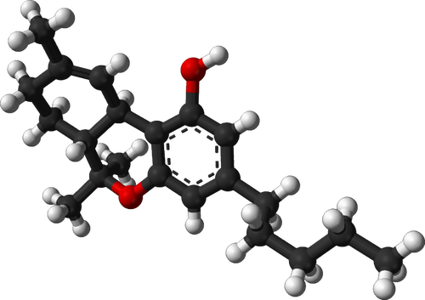
Workflow Diagram
Drug Name
CID
DDinter
Query
Results
Machine Learning
Data Processing
Notes:
A significant portion of our time was dedicated to data cleaning and preprocessing. This experience mirrored real-world scenarios, where raw data often comes with challenges like incompleteness, redundancy, and imbalance. Working through these issues gave us a deeper appreciation of the complexity of real-world data and the critical role of preprocessing in any machine-learning pipeline.

Slide 4
Data Extraction & Cleaning
1. Raw Data: The initial dataset was obtained from DDInter, mapping drug-drug interactions (DDI). The data included drug names and associated interaction labels.
Additional Data Sources:
Drug CIDs: A mapping of drug names to their respective PubChem Compound Identifiers (CIDs).
PubChem Data: Chemical and molecular descriptors for drugs were retrieved using CIDs from PubChem
2. Handling Multiple CIDs
Issue: Multiple CIDs exist for the same drug, each representing different molecular forms or chemical properties (e.g., Naltrexone with 13 CIDs).
Decision: To leave multiple CIDs unprocessed due to time constraints and the lack of more granular data. This decision was made to allow for faster project progression.
Notes:
Franco

Slide 5
Data Extraction & Cleaning
3. Data Augmentation via Multiple CIDs
Augmentation: Multiple CIDs per drug naturally expand the dataset by providing additional examples, especially for underrepresented drugs.
Data Balance: This approach helps mitigate class imbalances by increasing the presence of drugs with fewer associated data points, enhancing model performance.
4. Current Limitations
Bias & Redundancy: The dataset may have biases due to overrepresentation of drugs with more CIDs, and redundancy due to similar chemical properties across multiple CIDs.
Future Refinement: The approach will be revisited if more data becomes available, considering potential methods like averaging descriptors or dimensionality reduction.
Lack of Relevant Features: We are relying only on molecular descriptors so far to train the machine learning models. This is not optimal, since we could also leverage pharmacokinetic and pharmacodynamic information as well that is very relevant for understanding the underlying phenomena.
Notes:
Franco

Slide 6
Data Set Challenges
Multiple CID Entries per Drug Name:
Each drug name in the PubChem database can have multiple CID entries.
This can result in row duplication when analyzing drug-drug interactions.
Class Imbalance for the Level Label:
The Level label exhibits significant class imbalance, which could affect model performance and require appropriate handling during training.
Limited Features for Analysis:
Currently focusing on molecular descriptors, which may not fully capture the underlying phenomena in drug-drug interactions.
Additional features or domain-specific data may be needed for better predictive accuracy.
Notes:
Franco

Slide 7
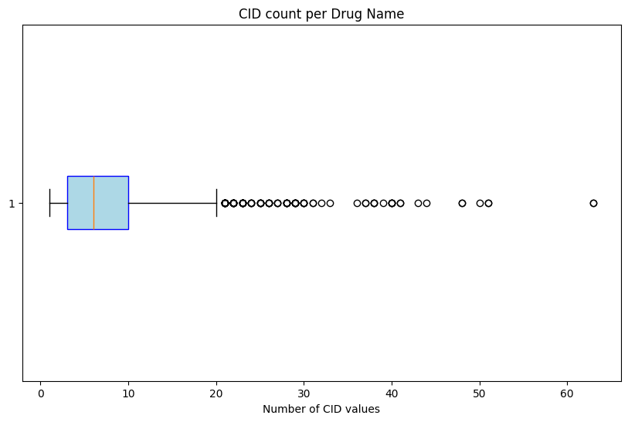
There are many unique CID values per drug name, this can bias the training process
Notes:
Franco Distribution of Unique CIDs per Drug Name
The analysis explores the unique CID (PubChem Compound ID) per drug. Each drug can have multiple CIDs corresponding to different versions or structures, leading to varying drug name-CID associations.

Slide 8
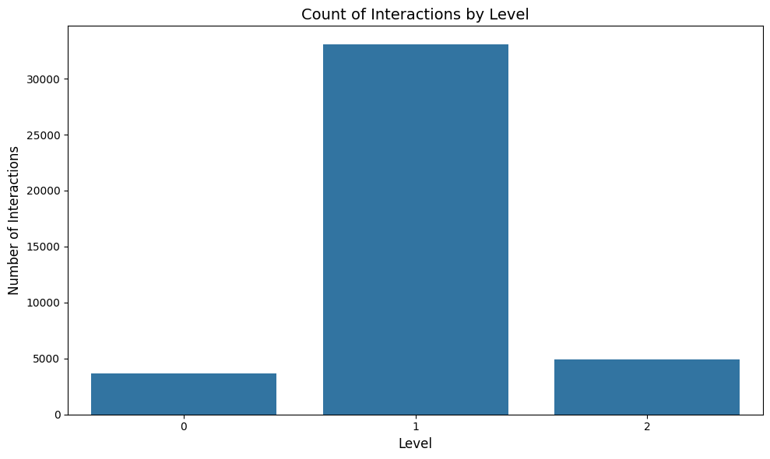
There is a class imbalance, having Level 1 ‘Minor’ Interaction as the most represented value
Notes:
Franco Distribution of Drug Interaction Levels The first visualization shows the distribution of drug interaction levels across the dataset. The interaction levels are classified as:
Moderate: Drugs with moderate interactions.
Minor: Drugs with minor interactions.
Major: Drugs with major interactions.

Slide 9
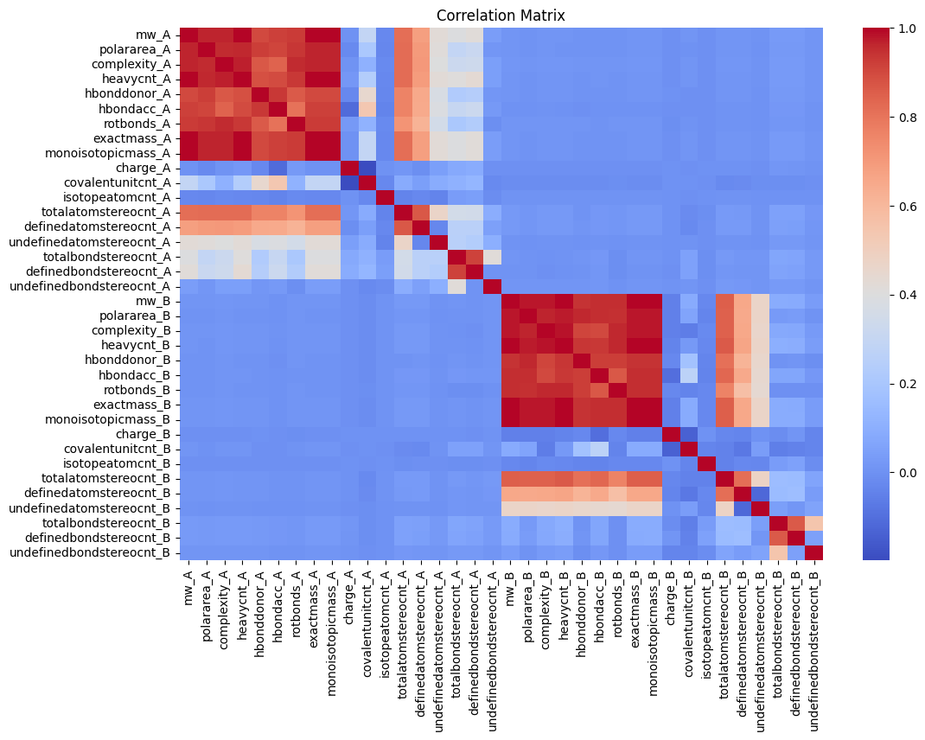
There is heavy multicollinearity between the columns for each drug, but not between drugs
Notes:
Franco Correlation Matrix - Group A vs Group B Drug Interactions
Drugs within Group A show high correlation with each other, indicating that they might exhibit similar drug-drug interaction behavior.
Group B drugs also exhibit high internal correlation.

Slide 10
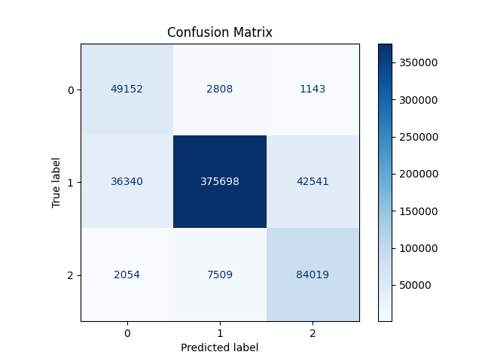
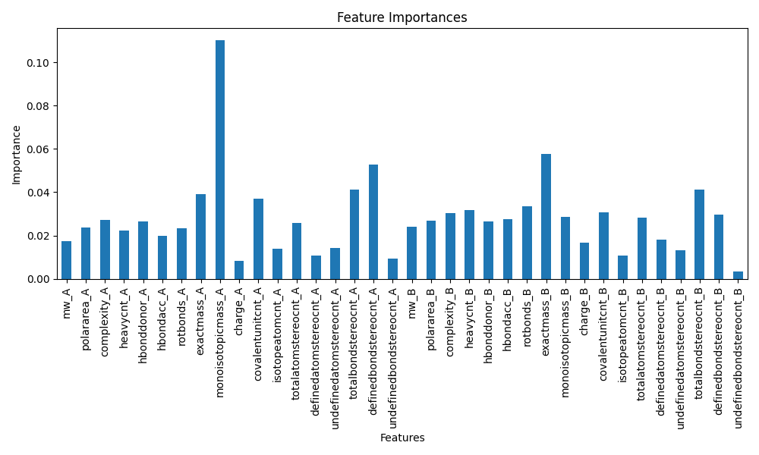
XGBoost with Weights
Notes:
Marius

Slide 11
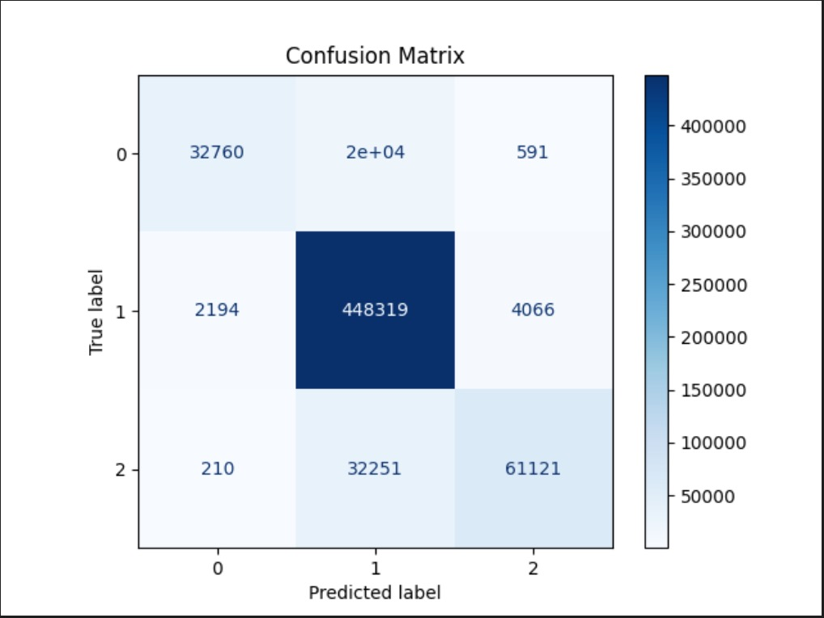
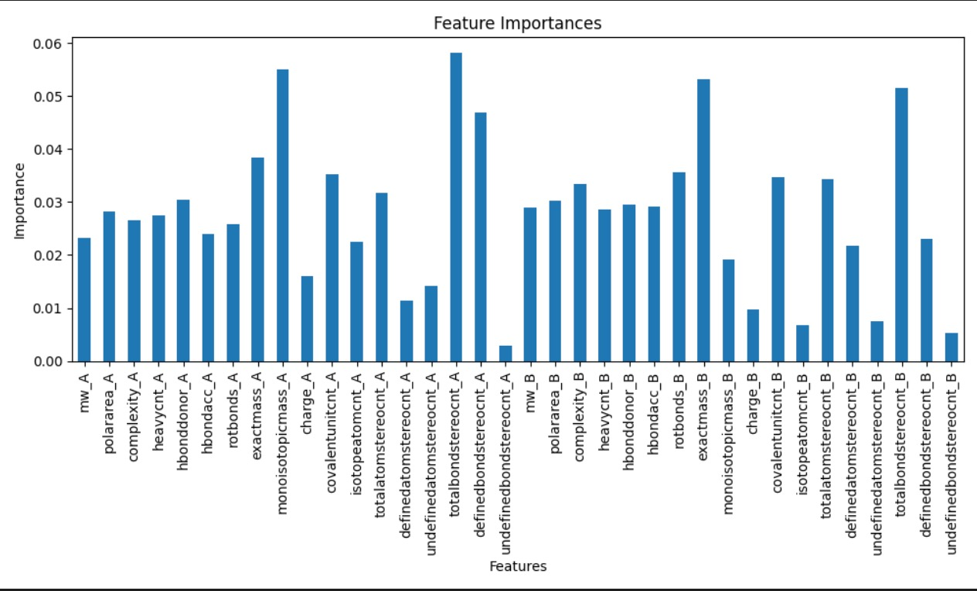
XGBoost without Weights
Notes:
Marius

Slide 12
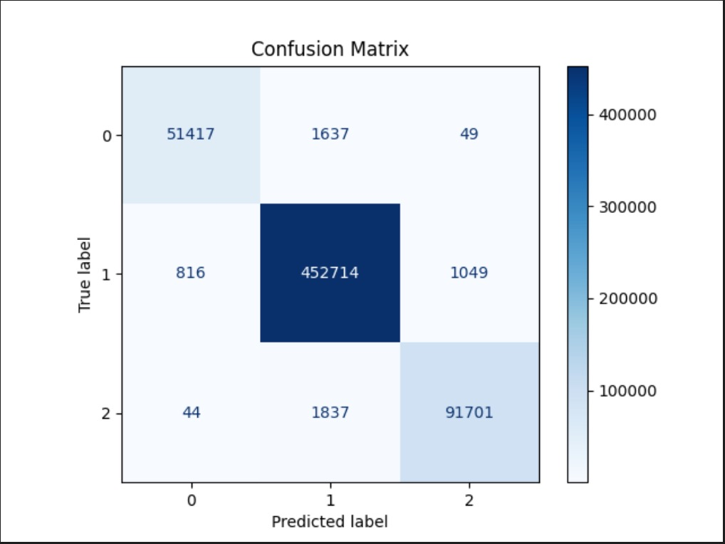
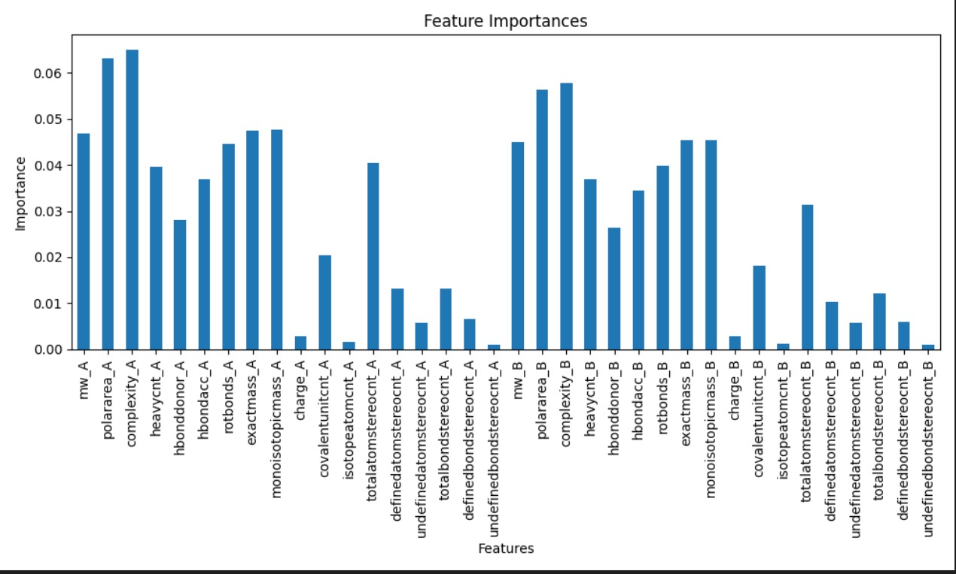
Random Forest
Notes:
Marius

Slide 13
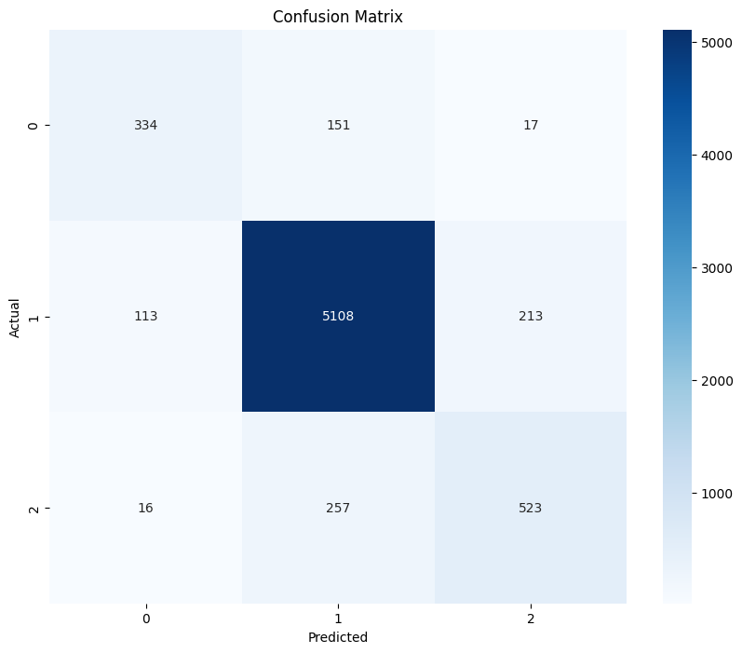
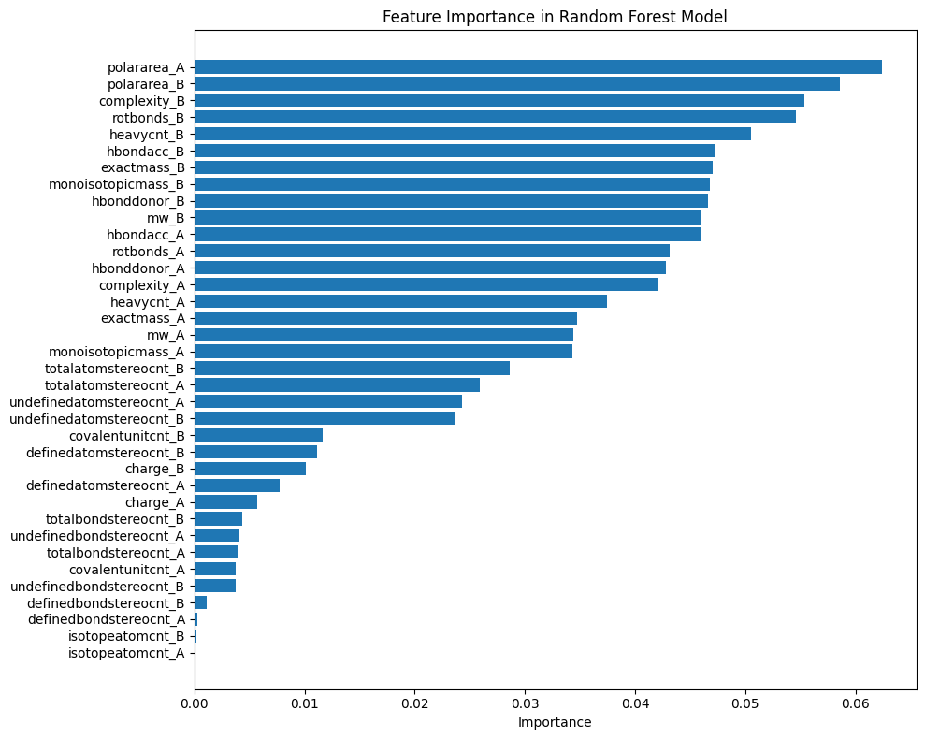
Random Forest W/O Duplicates
Notes:
Marius

Slide 14

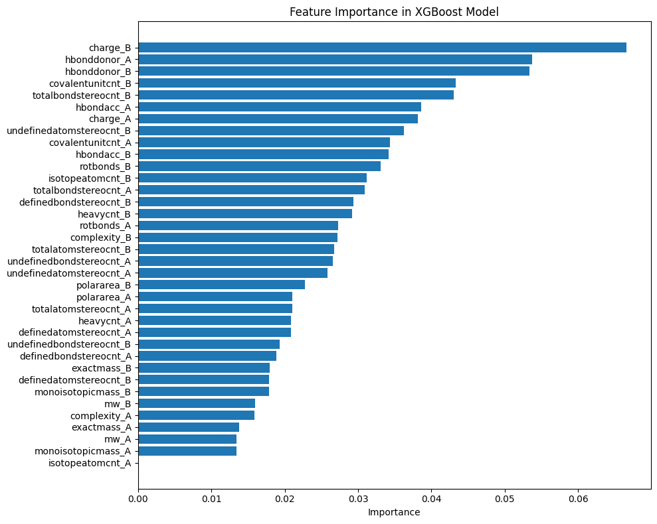
XGBoost W/O Duplicates
Notes:
Marius

Slide 15
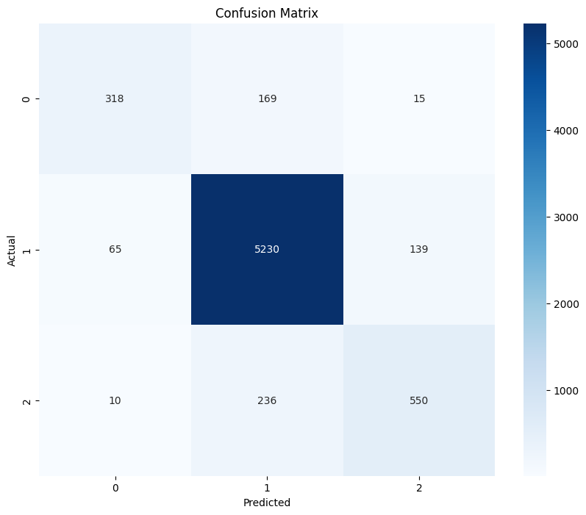
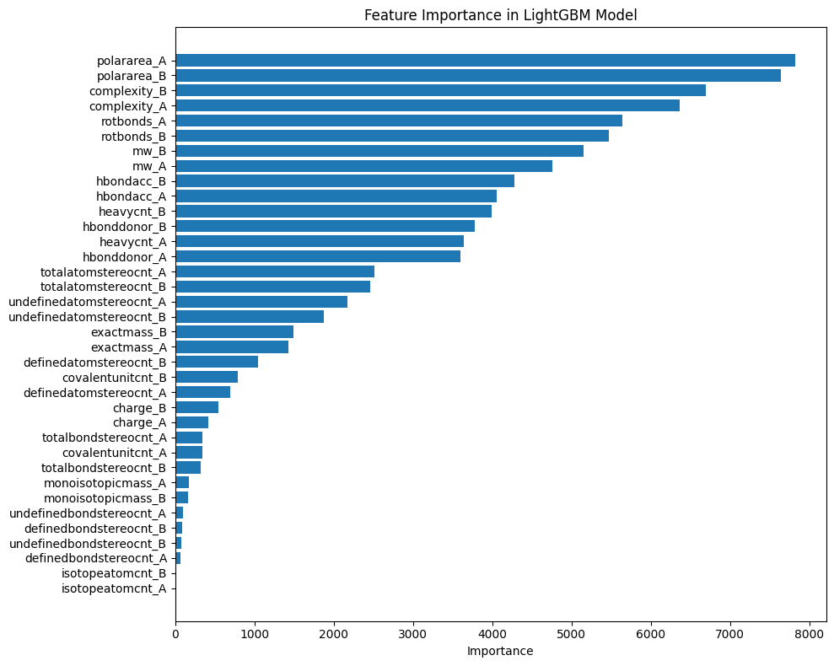
LightGBM W/O Duplicates
Notes:
Marius

Slide 16
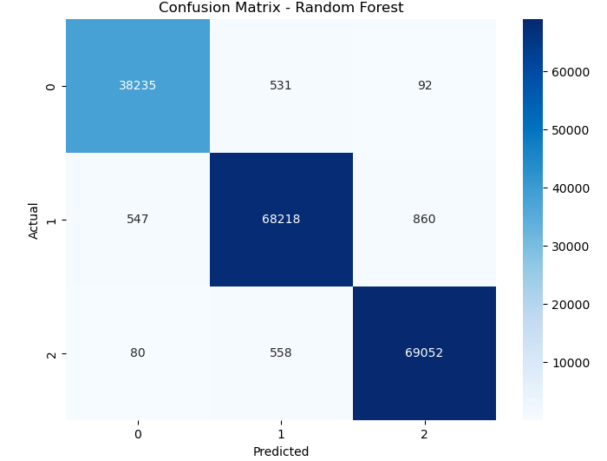
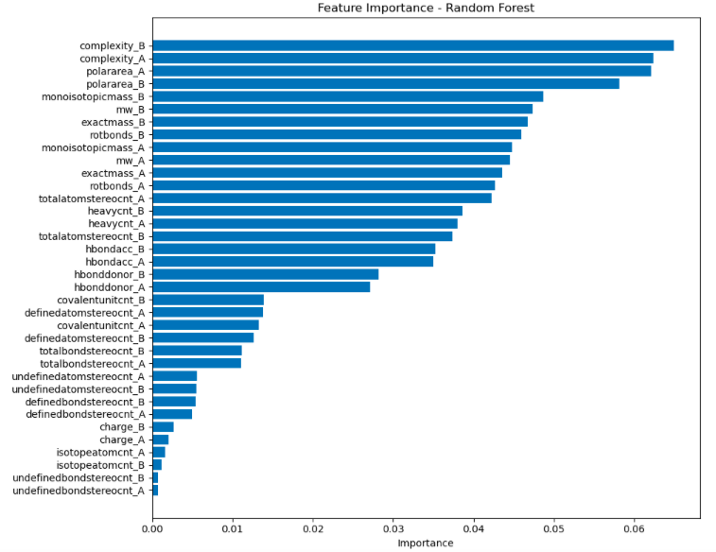
Random Forest - Class Manipulation
Notes:
Marius

Slide 17
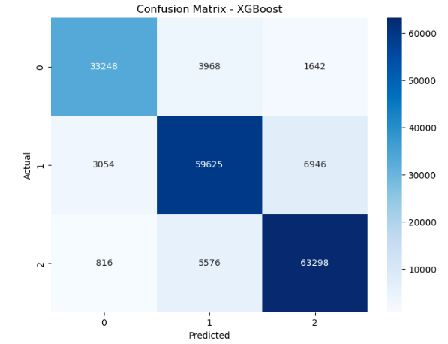
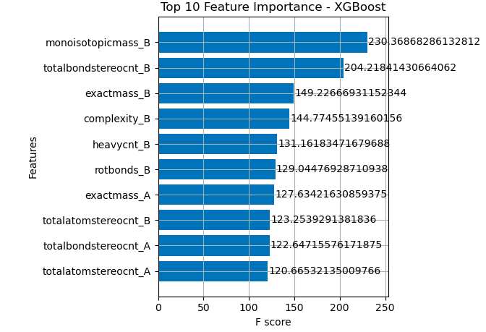
XGBoost - Class Manipulation
Notes:
Marius

Slide 18
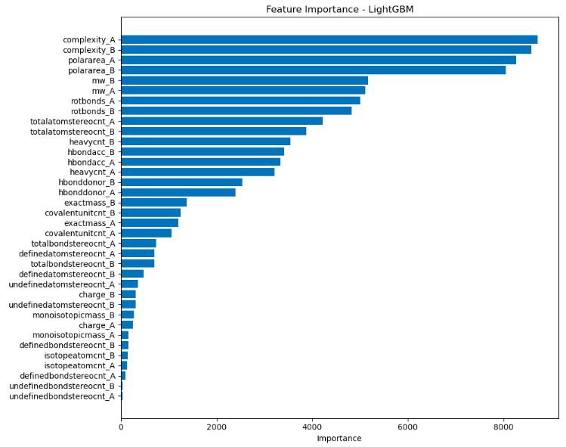
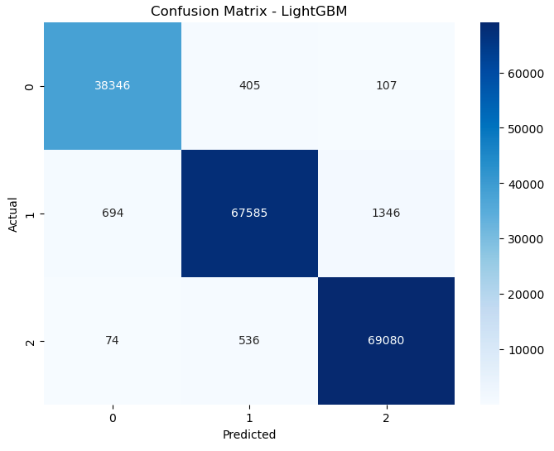
LightGBM - Class Manipulation
Notes:
Marius

Slide 19
Method Accuracy Comparison
Model | W/ Duplicates | W/O Duplicates | Class Manipulation
Random Forest | 0.991 | 0.886 | 0.9850
XGBoost | 0.899 | 0.901 | 0.8765
Light GBM | 0.866 | 0.9058 | 0.9823
Notes:
Marius

Slide 20
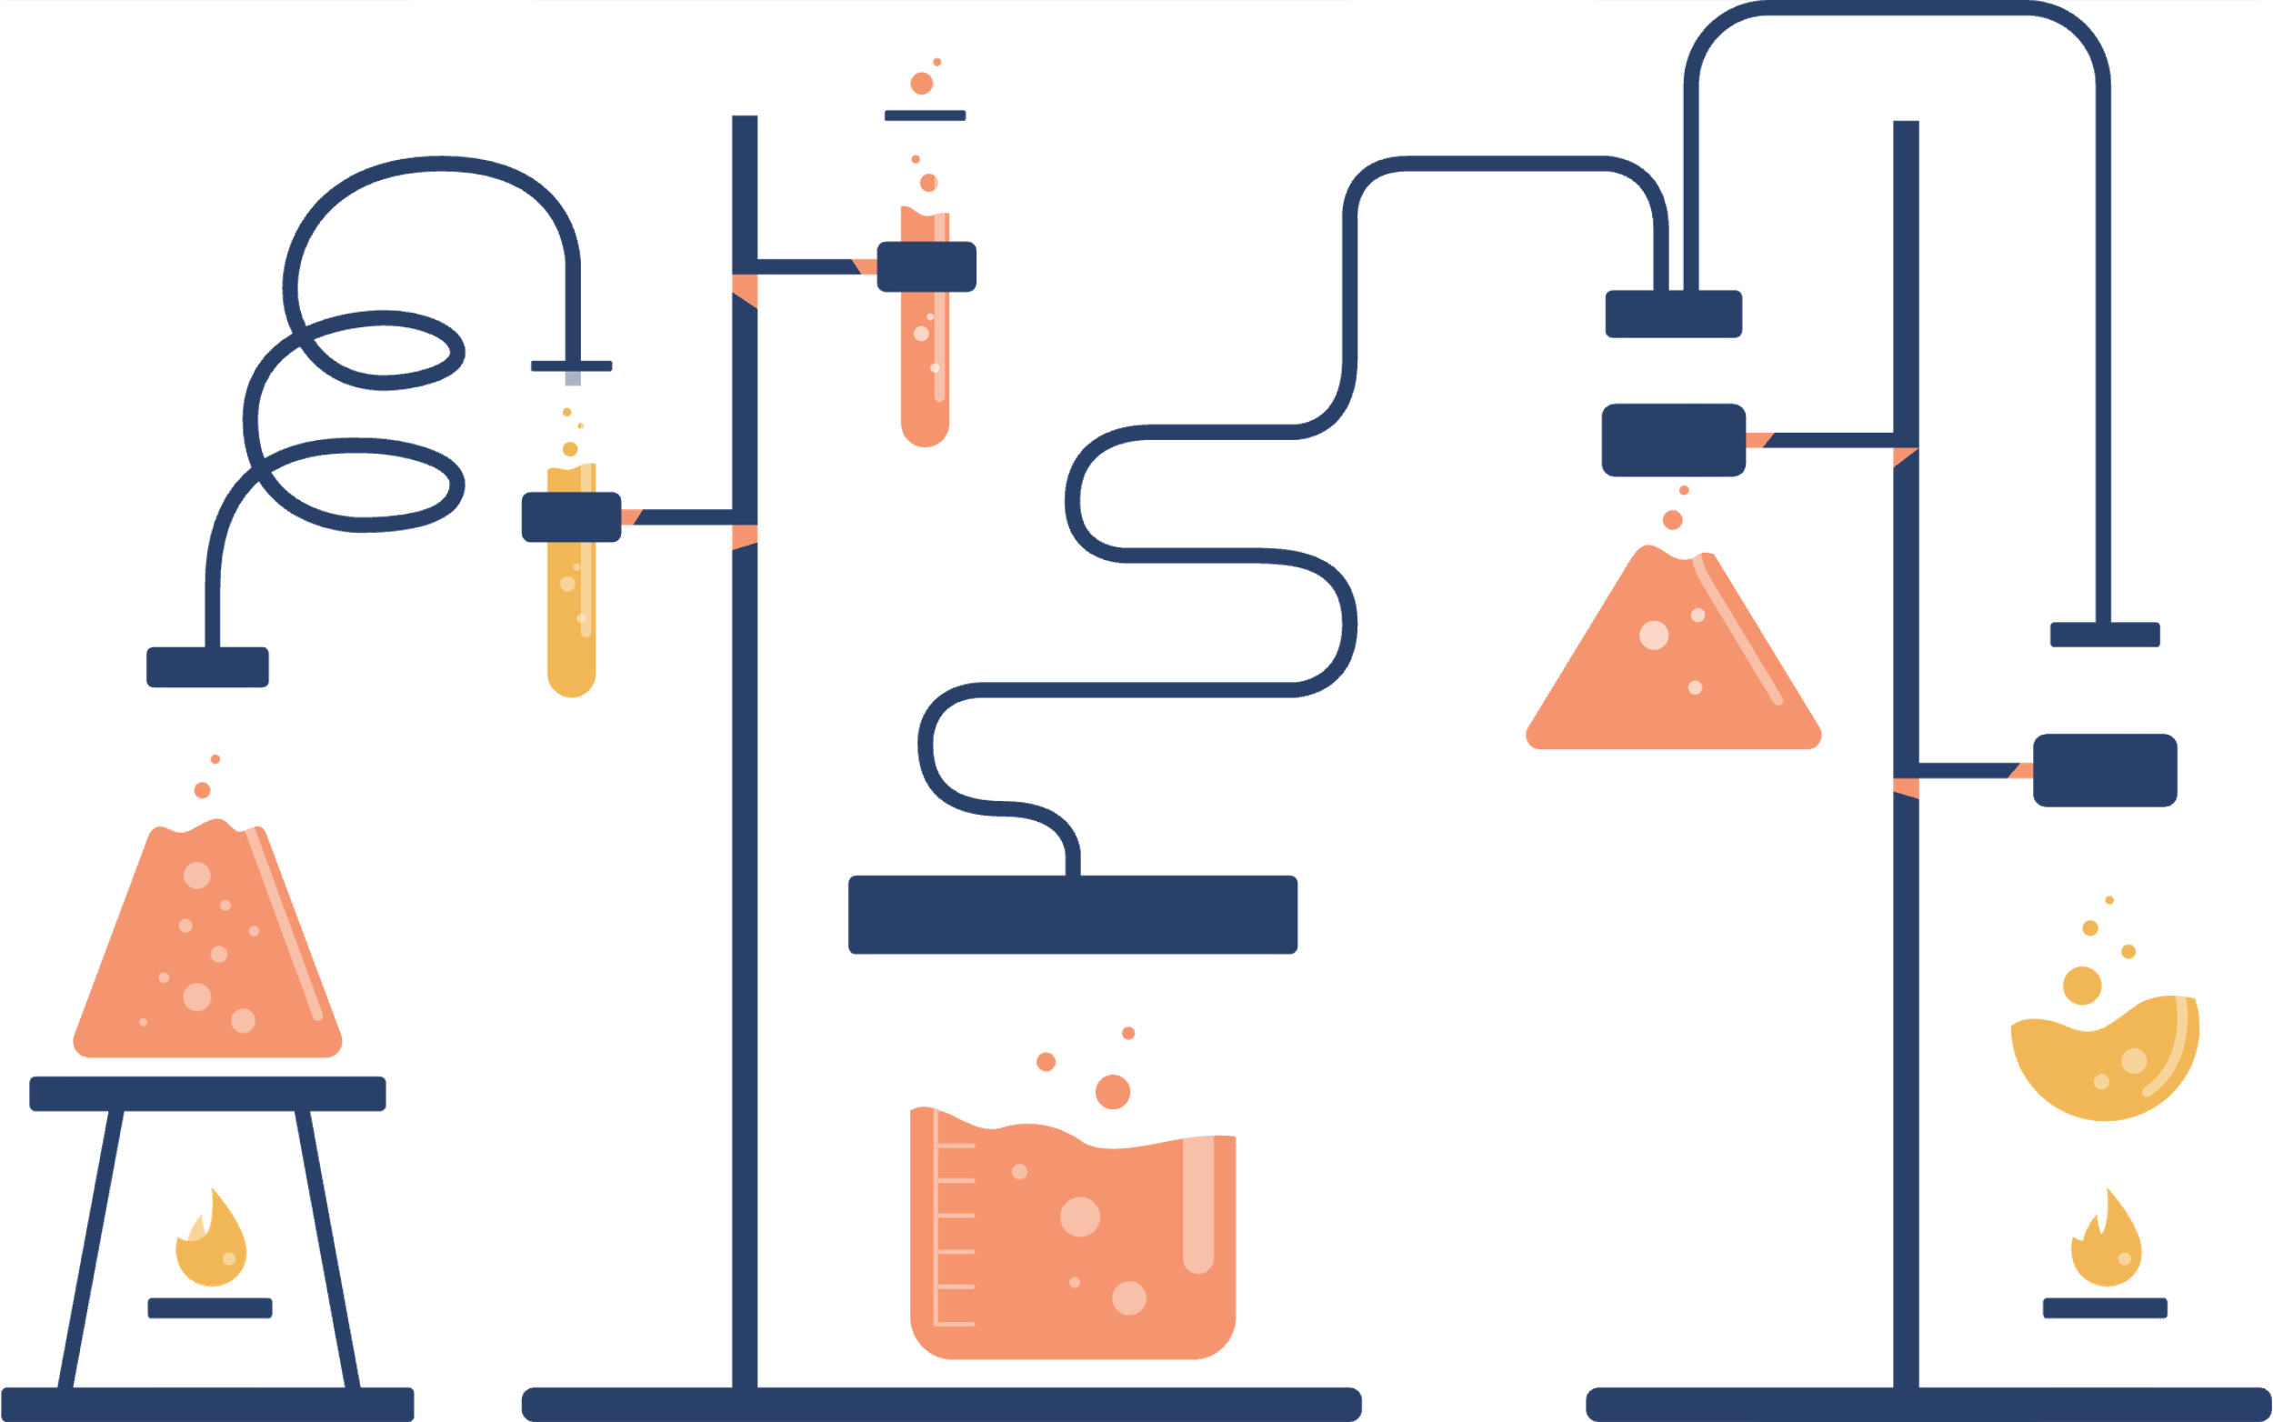
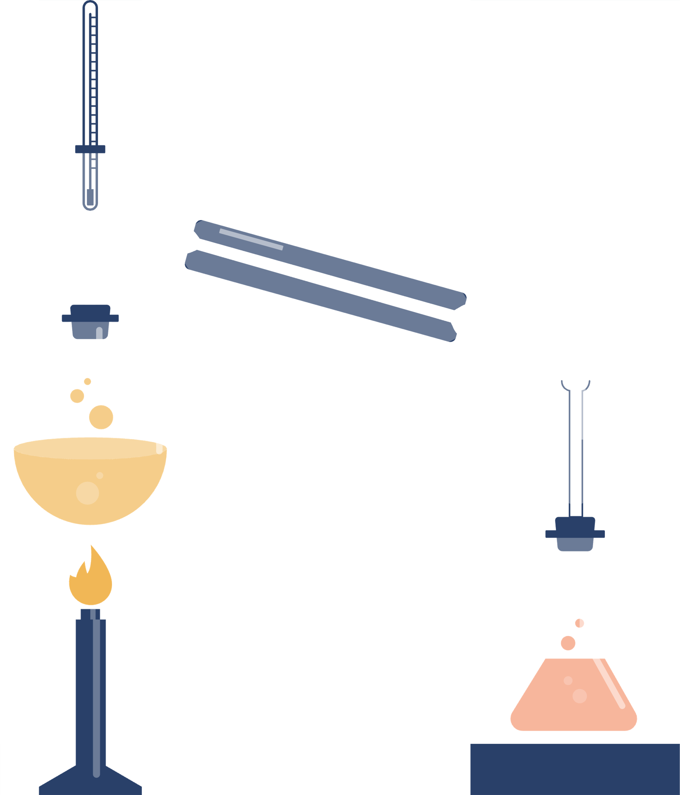


Learning outcomes
Handling redundancy in datasets
Gained an appreciation for the complexities of working with biological and chemical datasets, such as duplicate entries and imbalanced classes.
.
Addressing Class Imbalances
Analyzed how dataset preprocessing choices affect model accuracy
Notes:
Chehak
Through this project, we learned to preprocess complex datasets by handling duplicate CIDs and balancing class distribution using SMOTE. Comparing models with datasets having multiple and single CIDs revealed how redundancy and data structure impact model performance.
We also gained insights into the strengths and weaknesses of models like Random Forest, LightGBM, and XGBoost for handling imbalanced classification problems in drug-drug interaction prediction. This highlights the importance of robust preprocessing and evaluation techniques in achieving reliable predictive outcomes.

Slide 21


Thank you!

